Slide 1
Tabular Method for Minimization
Lecture 13,14&15

Slide 2
Tabular Method for Minimization
A tabular approach for minimization was proposed in the 1950s by Willard Quine and Edward McCluskey.
It became popular under the name Quine-McCluskey method.
It is a good method for simplifying logic expression with more variables.
In this course we will study tabular method for only 4 variable SOP expression.
It has two major steps:
Generation of Prime Implicants
Determination of a minimum cover

Slide 3
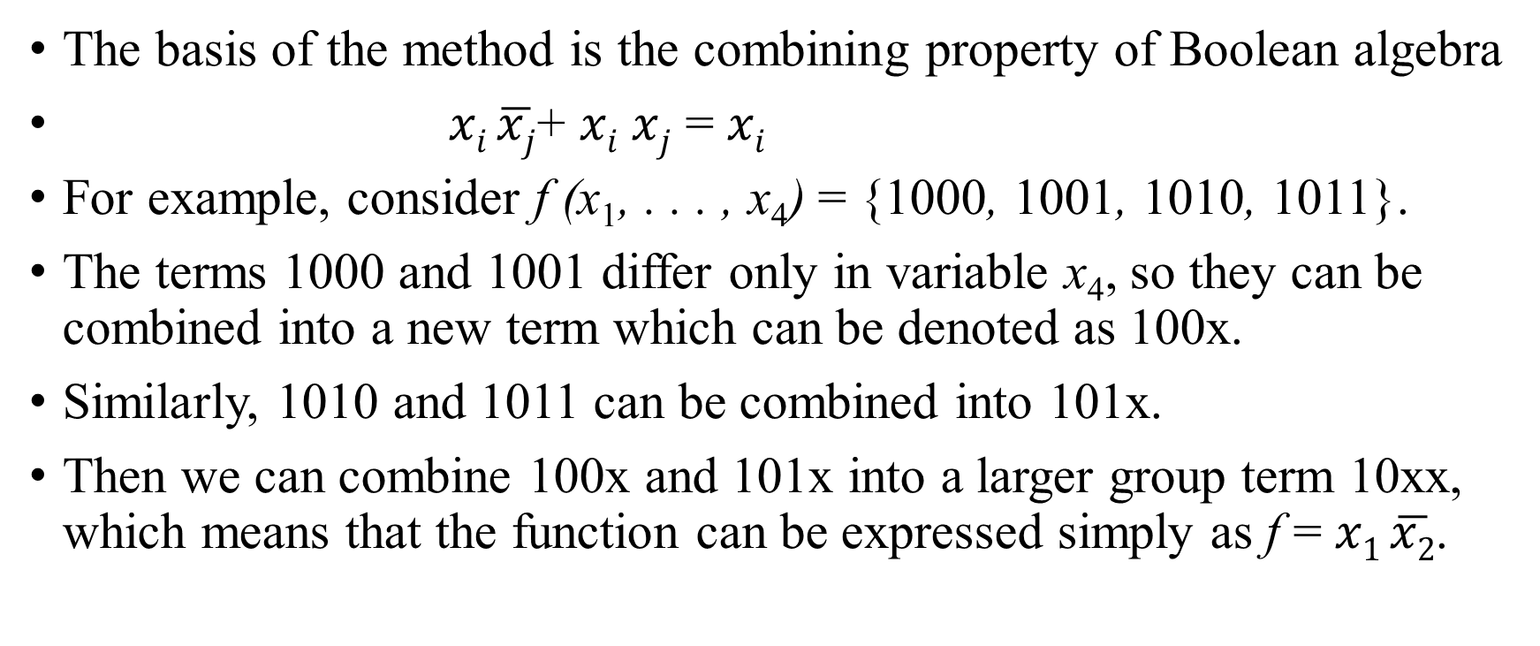
Generation of Prime Implicants
The basis of the method is the combining property of Boolean algebra
$xi \overline{xj}$+ $xi$ $xj$ = $xi$
For example, consider f (x₁, . . . , x₄) = {1000, 1001, 1010, 1011}.
The terms 1000 and 1001 differ only in variable x₄, so they can be combined into a new term which can be denoted as 100x.
Similarly, 1010 and 1011 can be combined into 101x.
Then we can combine 100x and 101x into a larger group term 10xx, which means that the function can be expressed simply as f = $x1 \overline{x2}$.

Slide 4

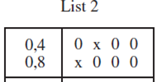








Example 1
The method can be explained by an example. Consider the function, f,
Step 1: Generation of Prime implicants: Firstly, the minterms are put in List 1 grouped as per the number of 1s present in them.
Each group has the same number of 1s. We may combine the adjacent groups, since they differ only in terms of one 1.
The minterms in list 1 can be combined to get implicants as in list 2.
To make the entries easily understood we have indicated the minterms that are combined in left column.
Next, we put tick mark against the terms in list 1 that are included in list 2.
Then, the terms in List 2 can be combined to get List 3 by repeating the above steps.
Now, since there is only 1 term in list 3, we cannot combine further.

Slide 5
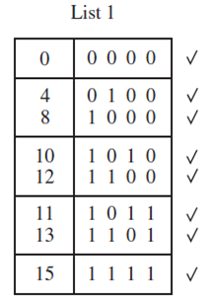
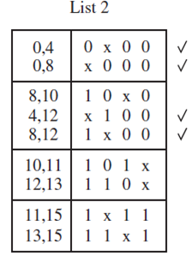
Contd.
The terms or implicants in each list without a check mark are the prime implicants of f .
Therefore, the set, P, of prime implicants is
P = {10x0, 101x, 110x, 1x11, 11x1, xx00}
= {p₁, p₂, p₃, p₄, p₅, p₆} (can be alternatively denoted in this manner)

Slide 6
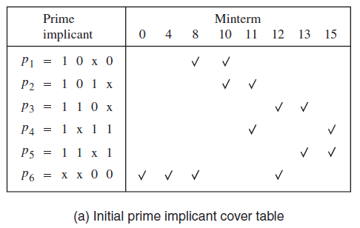
Determination of a Minimum Cover
To find a minimum-cost cover, we construct a prime implicant cover table as in fig. (a).
In the table, there will be a row for each prime implicant and a column for each minterm that must be covered.
In fig. (a), if a prime implicant has a minterm that is not part of other prime implicants, then it is an essential prime implicant.
So, p₆ is an essential prime implicant.

Slide 7
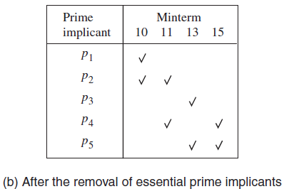
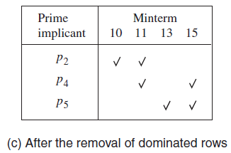
After removal of essential prime implicant (p₆) & columns (0,4,8,12), we get the table as in fig. (b)
In fig. (b), p₁ is dominated by p₂ because the latter has all minterms in p₁ and more. (row dominance)
Similarly, p₃ is dominated by p₅ . So, after removal of p₁ and p₃ we get fig. (c)
Now , out of p₂, p₄ and p_{5,} p₂ and p₅ must be chosen since they only cover minterms 10 and13 respectively. They also cover minterms 11 and 15. So, we can eliminate p₄.
Therefore, the final cover is,
C = {p2, p5, p6}= {101x, 11x1, xx00}
which means that the minimum-cost implementation of the function is

Slide 8
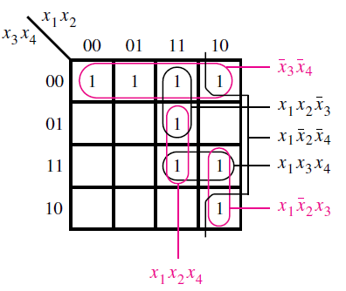
Contd.
Now, from, C = {p₂, p₅, p₆}= {101x, 11x1, xx00} =>
Now, the result we got is the same as what we got with the K-map method for the same function ( )

Slide 9
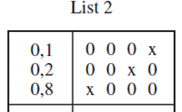



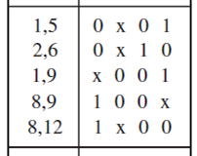

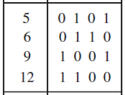

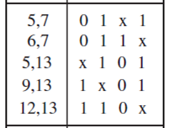



Example 2 (including don’t cares)
The don’t care minterms can be included in the initial list in the same way as the minterms for which f = 1.
Consider the given function,

Slide 10
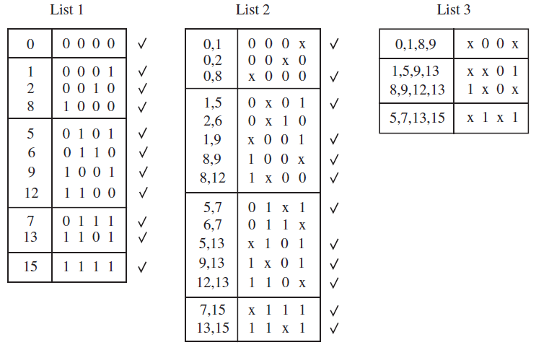
Step 1 : Generation of prime implicants
The prime implicants are: P = {00x0, 0x10, 011x, x00x, xx01, 1x0x, x1x1}
= {p₁, p₂, p₃, p₄, p₅, p₆, p₇}

Slide 11
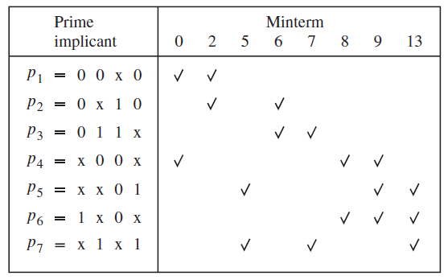
Step 2 : Determination of minimum cover
The initial prime implicant cover table is shown in figure (a).
The don’t care minterms are not included in the table because they do not have to be covered.
There are no essential prime implicants
No row dominance too.
Column 9 dominates column 8
– this is called as column dominance
And we can eliminate column 9
(in contrast to row dominance)
The reason is that when we choose a prime
implicant to cover the minterm that
corresponds to the dominated column,
this prime implicant will also cover the
minterm corresponding to the dominating
column
Similarly, column 13 can be
eliminated because it dominates column 5.
(a) Initial prime implicant cover table

Slide 12
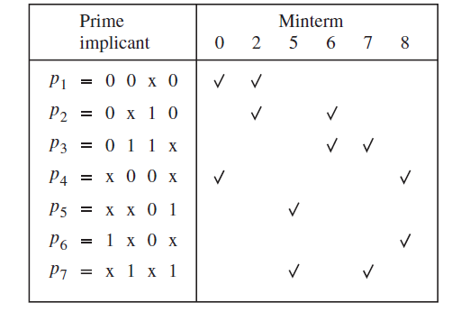
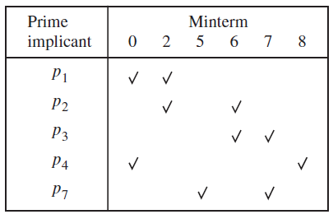
Contd.
The table in fig. (b), is after removal of columns 9 and 13. Here, row p₄ dominates p₆ and row p₇ dominates p₅.
So they can be removed
(c) After the removal of rows p₅ & p₆
(b) After the removal of columns 9 and 13

Slide 13
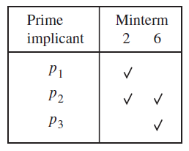
Contd.
In fig (c), p₄ and p₇ are essential to cover minterms 8 and 5, respectively.
So they can be removed and we get, table in fig (d)
In fig. (d), it is obvious that p₂ covers the remaining minterms 2 and 6
and it dominates both rows p₁ and p₃ as well.
The final cover is
C = {p₂, p₄, p₇}
= {0x10, x00x, x1x1}
and the function is implemented as
(c) After the removal of rows p₅ & p₆
(d) After including p₄ & p₇ in the cover

Slide 14
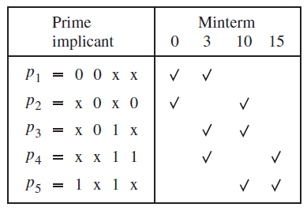
Example 3
Consider the function,
The prime implicants for this function are
P = {00xx, x0x0, x01x, xx11, 1x1x} = {p₁, p₂, p₃, p₄, p₅}
There are no essential prime implicants.
Also, there are no dominant rows or columns.
Moreover, all prime implicants have the same
cost because each of them is implemented with
two literals.
Thus, the table does not provide any clues that
can be used to select a minimum-cost cover.
(a) Initial prime implicant cover table

Slide 15
Contd.
In this case, a good practical approach is to use the concept of branching.
We can choose any prime implicant, say p₃, and first choose to include this prime implicant in the final cover.
Then we can determine the rest of the final cover in the usual way and compute its cost.
Next we try the other possibility by excluding p₃ from the final cover and determine the resulting cost.
We compare the costs and choose the less expensive alternative.

Slide 16
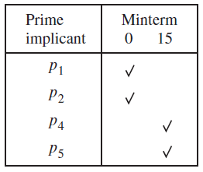
Contd.
Figure (b) gives the cover table that is left if p₃ is included in the final cover.
The table does not include minterms 3 and 10 because they are covered by p₃.
The table indicates that a complete cover must include either p₁ or p₂ to cover minterm 0 and either p₄ or p₅ to cover minterm 15.
Therefore, a complete cover can be
C = {p₁, p₃, p₄}
(b) After including p₃ in the cover and
minterms 3 & 10.

Slide 17
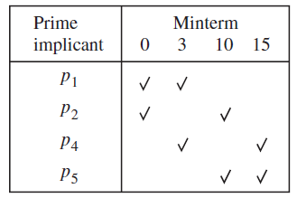
Contd.
The alternative of excluding p₃ leads to the cover table in fig. (c).
Here, we see that a minimum-cost cover requires only two prime implicants.
One possibility is to choose p₁ and p₅.
The other possibility is to choose p₂ and p₄.
Hence a minimum-cost cover is just
C_{min} = {p1, p5}= {00xx, 1x1x}
So, out of covers C and C_{min} , the latter
is smaller so we choose it.
Therefore, the function is realized as,
(c) After excluding p₃ in the cover

Slide 18
Summary of the Tabular Method
1. Starting with a list that represent the minterms where f = 1 or a don’t care condition, generate the prime implicants by successive pairwise comparisons of the rows.
2. Derive a cover table which indicates the minterms where f = 1 that are covered by each prime implicant.
3. Include the essential prime implicants (if any) in the final cover and reduce the table by removing both these prime implicants and the covered minterms.
4. Use the concept of row and column dominance to reduce the cover table further. A dominated row is removed only if the cost of its prime implicant is greater than or equal to the cost of the dominating row’s prime implicant.
5. Repeat steps 3 and 4 until the cover table is either empty or no further reduction of the table is possible.
6. If the reduced cover table is not empty, then use the branching approach to determine the remaining prime implicants that should be included in a minimum cost cover.

